Slide 1
Threshold Trimming Runs

Slide 2
Threshold trimming algorithm
Clear all trim_dac values to 0 for all the channels.
Perform scurve for all channels to get Mean_threshold & Mean_enc values @ Arm_dac= 2fC.
Starting from ch0, get trim_dac vs. Threshold curve and use linear fit to get trim_dac value which gives Threshold of 2fC.
Repeat this for all 128 channels and get trim_dac values from curve fitting method.
Repeat scurve all channels post trimming to compare the results.

Slide 3
Run1
Performed s-curves at [5fC, 4fC,3fC,2fC,1fC] before trimming of dacs .
Set Arming_dac = 2fC for threshold trimming routine and performed trimming.
Repeated s-curves at [5fC, 4fC,3fC,2fC,1fC] after threshold trimming to compare the results.

Slide 4
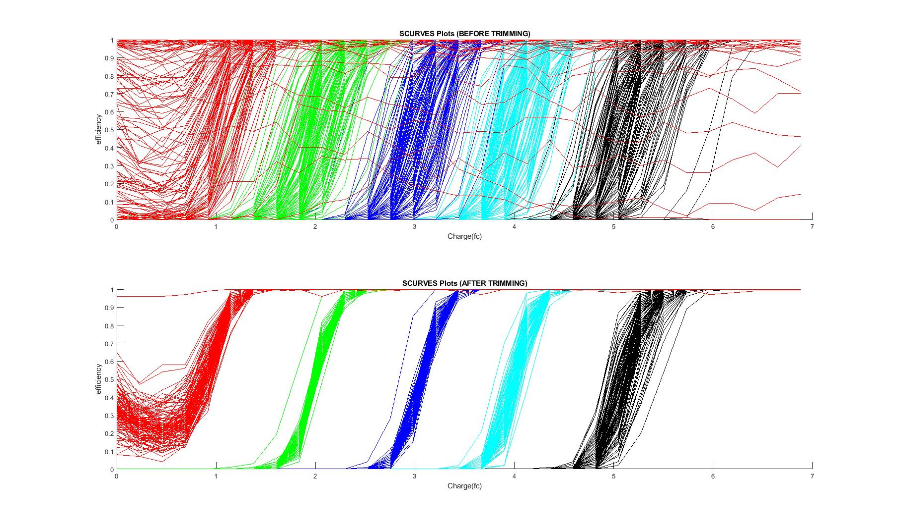
Scurve plots before & after trimming
25,HG
We used Arming_Th =[1,2,3,4,5]fC for extracting different s-curves.

Slide 5
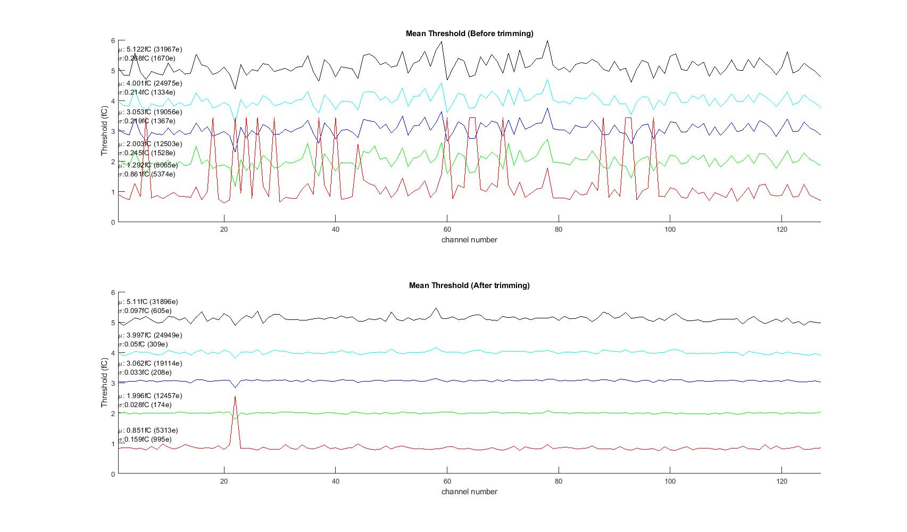
Threshold plots comparison

Slide 6
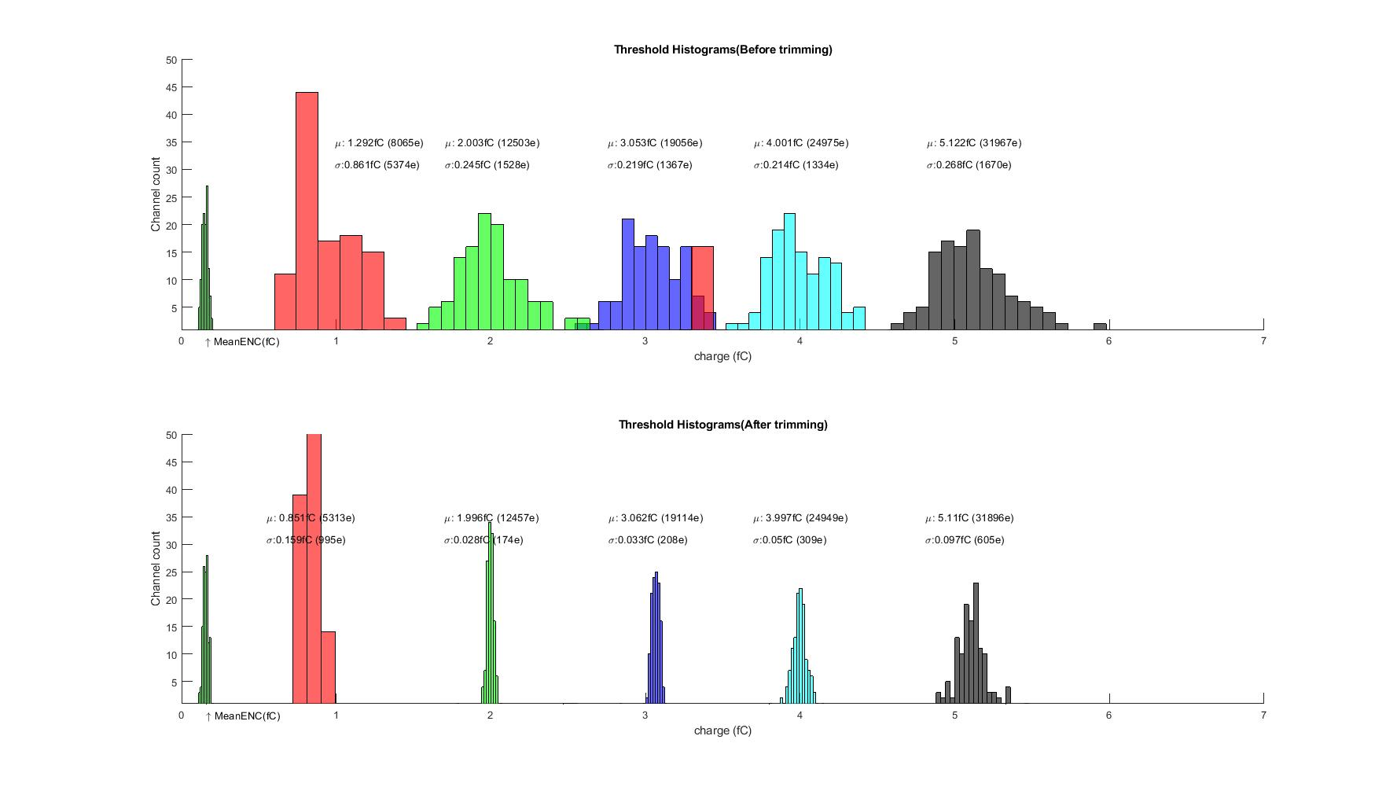
Threshold histograms comparison

Slide 7
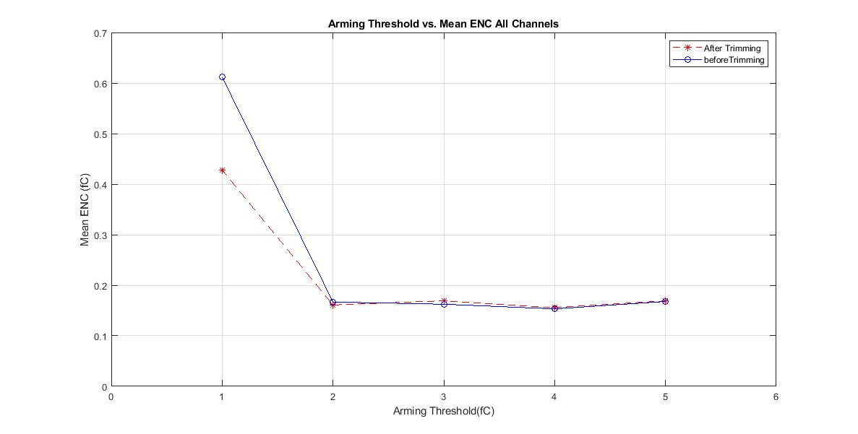
Arming Threshold(Arm_dac) vs. ENC plot

Slide 8
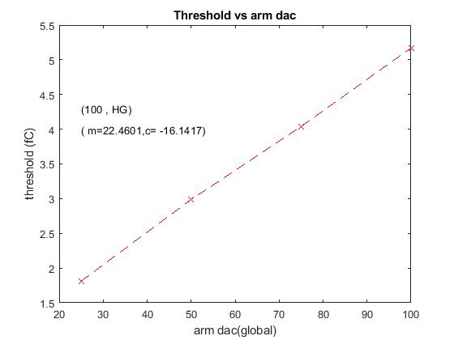
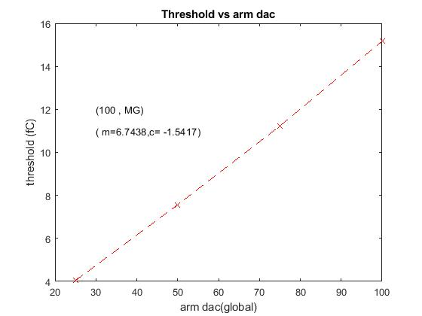
Arm_dac to fC
Set Arm_dac=0
Run scurve all channels.
Calculate mean threshold
Increment arm_dac
Loop 2 to 4 until arm_dac =100
Removed outliers and fitted the curve with linear fit model to get fC for arm dac steps.
Arm_dac = m * (fC) + c;

Slide 9
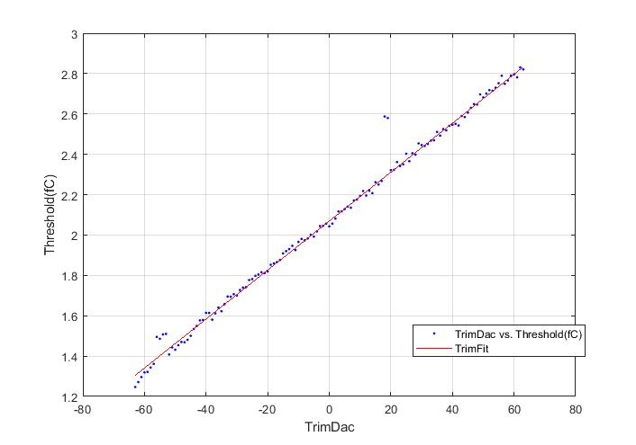
Trim_dac Plot
Arming_th = 2fC (Target )

Slide 10
Threshold(0, 1) = 1.260113 Trim_dac(0, 1) = -60.000000
Threshold(0, 2) = 1.328815 Trim_dac(0, 2) = -59.000000
Threshold(0, 3) = 1.324516 Trim_dac(0, 3) = -58.000000
Threshold(0, 4) = 1.340350 Trim_dac(0, 4) = -57.000000
Threshold(0, 5) = 1.358092 Trim_dac(0, 5) = -56.000000
Threshold(0, 6) = 1.370995 Trim_dac(0, 6) = -55.000000
Threshold(0, 7) = 1.369780 Trim_dac(0, 7) = -54.000000
Threshold(0, 8) = 1.519009 Trim_dac(0, 8) = -53.000000
Threshold(0, 9) = 1.412037 Trim_dac(0, 9) = -52.000000
Threshold(0, 10) = 1.411097 Trim_dac(0, 10) = -51.000000
Threshold(0, 11) = 1.447466 Trim_dac(0, 11) = -50.000000
Threshold(0, 12) = 1.466397 Trim_dac(0, 12) = -49.000000
Threshold(0, 13) = 1.478327 Trim_dac(0, 13) = -48.000000
Threshold(0, 14) = 1.501430 Trim_dac(0, 14) = -47.000000
Threshold(0, 15) = 1.495310 Trim_dac(0, 15) = -46.000000
Threshold(0, 16) = 1.521623 Trim_dac(0, 16) = -45.000000
Threshold(0, 17) = 1.538304 Trim_dac(0, 17) = -44.000000
Threshold(0, 18) = 1.526790 Trim_dac(0, 18) = -43.000000
Threshold(0, 19) = 1.546116 Trim_dac(0, 19) = -42.000000
Threshold(0, 20) = 1.559583 Trim_dac(0, 20) = -41.000000
Threshold(0, 21) = 1.588315 Trim_dac(0, 21) = -40.000000
Threshold(0, 22) = 1.587793 Trim_dac(0, 22) = -39.000000
Threshold(0, 23) = 1.605849 Trim_dac(0, 23) = -38.000000
Threshold(0, 24) = 1.632482 Trim_dac(0, 24) = -37.000000
Threshold(0, 25) = 1.624997 Trim_dac(0, 25) = -36.000000
Threshold(0, 26) = 1.622858 Trim_dac(0, 26) = -35.000000
Threshold(0, 27) = 1.653420 Trim_dac(0, 27) = -34.000000
Threshold(0, 28) = 1.674554 Trim_dac(0, 28) = -33.000000
Threshold(0, 29) = 1.700143 Trim_dac(0, 29) = -32.000000
Threshold(0, 30) = 1.685206 Trim_dac(0, 30) = -31.000000
Threshold(0, 31) = 1.726912 Trim_dac(0, 31) = -30.000000
Threshold(0, 32) = 1.706831 Trim_dac(0, 32) = -29.000000
Threshold(0, 33) = 1.731442 Trim_dac(0, 33) = -28.000000
Threshold(0, 34) = 1.732055 Trim_dac(0, 34) = -27.000000
Threshold(0, 35) = 1.746492 Trim_dac(0, 35) = -26.000000
Threshold(0, 36) = 1.776647 Trim_dac(0, 36) = -25.000000
Threshold(0, 37) = 1.775035 Trim_dac(0, 37) = -24.000000
Threshold(0, 38) = 1.779834 Trim_dac(0, 38) = -23.000000
Threshold(0, 39) = 1.808015 Trim_dac(0, 39) = -22.000000
Threshold(0, 40) = 1.827373 Trim_dac(0, 40) = -21.000000
Threshold(0, 41) = 1.828545 Trim_dac(0, 41) = -20.000000
Threshold(0, 42) = 1.851505 Trim_dac(0, 42) = -19.000000
Threshold(0, 43) = 1.843345 Trim_dac(0, 43) = -18.000000
Threshold(0, 44) = 1.879890 Trim_dac(0, 44) = -17.000000
Threshold(0, 45) = 1.904259 Trim_dac(0, 45) = -16.000000
Threshold(0, 46) = 1.919998 Trim_dac(0, 46) = -15.000000
Threshold(0, 47) = 1.927874 Trim_dac(0, 47) = -14.000000
Threshold(0, 48) = 1.914772 Trim_dac(0, 48) = -13.000000
Threshold(0, 49) = 1.905146 Trim_dac(0, 49) = -12.000000
Threshold(0, 50) = 1.951641 Trim_dac(0, 50) = -11.000000
Threshold(0, 51) = 1.965974 Trim_dac(0, 51) = -10.000000
Threshold(0, 52) = 1.970661 Trim_dac(0, 52) = -9.000000
Threshold(0, 53) = 1.995441 Trim_dac(0, 53) = -8.000000
Threshold(0, 54) = 1.970568 Trim_dac(0, 54) = -7.000000
Threshold(0, 55) = 1.987180 Trim_dac(0, 55) = -6.000000
Threshold(0, 56) = 1.994222 Trim_dac(0, 56) = -5.000000
Threshold(0, 57) = 2.011818 Trim_dac(0, 57) = -4.000000
Threshold(0, 58) = 2.012277 Trim_dac(0, 58) = -3.000000
Threshold(0, 59) = 2.055617 Trim_dac(0, 59) = -2.000000
Threshold(0, 60) = 2.025247 Trim_dac(0, 60) = -1.000000
Threshold(0, 61) = 2.084669 Trim_dac(0, 61) = 0.000000
Threshold(0, 62) = 2.062291 Trim_dac(0, 62) = 1.000000
Threshold(0, 63) = 2.079079 Trim_dac(0, 63) = 2.000000
Threshold(0, 64) = 2.101561 Trim_dac(0, 64) = 3.000000
Threshold(0, 65) = 2.117652 Trim_dac(0, 65) = 4.000000
Threshold(0, 66) = 2.134135 Trim_dac(0, 66) = 5.000000
Threshold(0, 67) = 2.141947 Trim_dac(0, 67) = 6.000000
Threshold(0, 68) = 2.126137 Trim_dac(0, 68) = 7.000000
Threshold(0, 69) = 2.147637 Trim_dac(0, 69) = 8.000000
Threshold(0, 70) = 2.151352 Trim_dac(0, 70) = 9.000000
Threshold(0, 71) = 2.195325 Trim_dac(0, 71) = 10.000000
Threshold(0, 72) = 2.195271 Trim_dac(0, 72) = 11.000000
Threshold(0, 73) = 2.210659 Trim_dac(0, 73) = 12.000000
Threshold(0, 74) = 2.197973 Trim_dac(0, 74) = 13.000000
Threshold(0, 75) = 2.244741 Trim_dac(0, 75) = 14.000000
Threshold(0, 76) = 2.239348 Trim_dac(0, 76) = 15.000000
Threshold(0, 77) = 2.271381 Trim_dac(0, 77) = 16.000000
Threshold(0, 78) = 2.301878 Trim_dac(0, 78) = 17.000000
Threshold(0, 79) = 2.326693 Trim_dac(0, 79) = 18.000000
Threshold(0, 80) = 2.315723 Trim_dac(0, 80) = 19.000000
Threshold(0, 81) = 2.315708 Trim_dac(0, 81) = 20.000000
Threshold(0, 82) = 2.364853 Trim_dac(0, 82) = 21.000000
Threshold(0, 83) = 2.360223 Trim_dac(0, 83) = 22.000000
Threshold(0, 84) = 2.354579 Trim_dac(0, 84) = 23.000000
Threshold(0, 85) = 2.374134 Trim_dac(0, 85) = 24.000000
Threshold(0, 86) = 2.377997 Trim_dac(0, 86) = 25.000000
Threshold(0, 87) = 2.380286 Trim_dac(0, 87) = 26.000000
Threshold(0, 88) = 2.412580 Trim_dac(0, 88) = 27.000000
Threshold(0, 89) = 2.414883 Trim_dac(0, 89) = 28.000000
Threshold(0, 90) = 2.430016 Trim_dac(0, 90) = 29.000000
Threshold(0, 91) = 2.442644 Trim_dac(0, 91) = 30.000000
Threshold(0, 92) = 2.467878 Trim_dac(0, 92) = 31.000000
Threshold(0, 93) = 2.454428 Trim_dac(0, 93) = 32.000000
Threshold(0, 94) = 2.460704 Trim_dac(0, 94) = 33.000000
Threshold(0, 95) = 2.467975 Trim_dac(0, 95) = 34.000000
Threshold(0, 96) = 2.482014 Trim_dac(0, 96) = 35.000000
Threshold(0, 97) = 2.528907 Trim_dac(0, 97) = 36.000000
Threshold(0, 98) = 2.491166 Trim_dac(0, 98) = 37.000000
Threshold(0, 99) = 2.549077 Trim_dac(0, 99) = 38.000000
Threshold(0, 100) = 2.584249 Trim_dac(0, 100) = 39.000000
Threshold(0, 101) = 2.565440 Trim_dac(0, 101) = 40.000000
Threshold(0, 102) = 2.568105 Trim_dac(0, 102) = 41.000000
Threshold(0, 103) = 2.584871 Trim_dac(0, 103) = 42.000000
Threshold(0, 104) = 2.599778 Trim_dac(0, 104) = 43.000000
Threshold(0, 105) = 2.607405 Trim_dac(0, 105) = 44.000000
Threshold(0, 106) = 2.615596 Trim_dac(0, 106) = 45.000000
Threshold(0, 107) = 2.612607 Trim_dac(0, 107) = 46.000000
Threshold(0, 108) = 2.641987 Trim_dac(0, 108) = 47.000000
Threshold(0, 109) = 2.654884 Trim_dac(0, 109) = 48.000000
Threshold(0, 110) = 2.688882 Trim_dac(0, 110) = 49.000000
Threshold(0, 111) = 2.680698 Trim_dac(0, 111) = 50.000000
Threshold(0, 112) = 2.690155 Trim_dac(0, 112) = 51.000000
Threshold(0, 113) = 2.762506 Trim_dac(0, 113) = 52.000000
Threshold(0, 114) = 2.703790 Trim_dac(0, 114) = 53.000000
Threshold(0, 115) = 2.754234 Trim_dac(0, 115) = 54.000000
Threshold(0, 116) = 2.763567 Trim_dac(0, 116) = 55.000000
Threshold(0, 117) = 2.749501 Trim_dac(0, 117) = 56.000000
Threshold(0, 118) = 2.771030 Trim_dac(0, 118) = 57.000000
Threshold(0, 119) = 2.798224 Trim_dac(0, 119) = 58.000000
Threshold(0, 120) = 2.769989 Trim_dac(0, 120) = 59.000000
Threshold(0, 121) = 2.786704 Trim_dac(0, 121) = 60.000000

